Slide 1
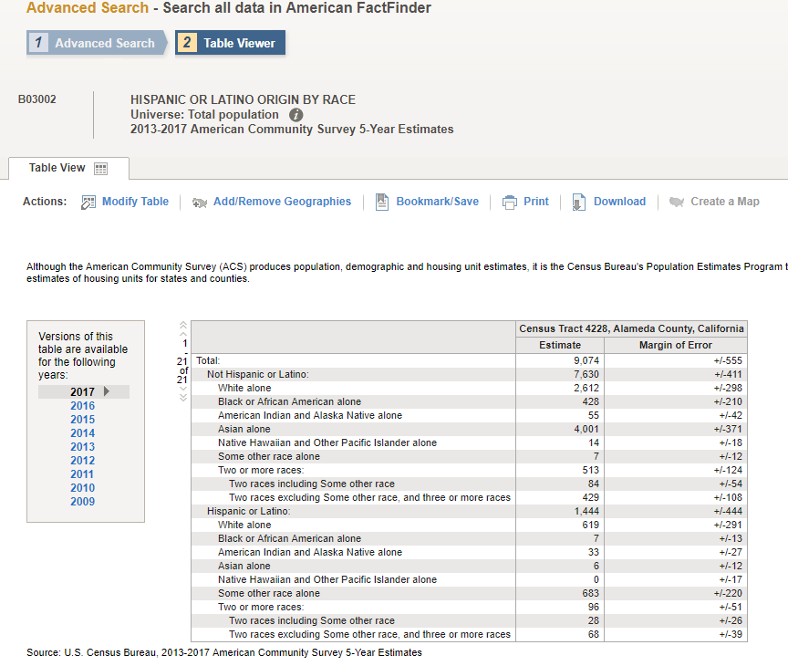
Reminders for Assignment 1
Make sure your census tract has data for 2009 and 2017
You can check by looking up one table for your census tract and see what years are available

Slide 2
Reminders for Assignment 1
Make sure to include all the variables noted in the assignment sheet
Since you are using 5-year datasets for your census tract, you need to use 5-year datasets for your surrounding city when making comparisons
The surrounding city will have 1-year datasets and 5-year datasets

Slide 3
Reminders for Assignment 1
There are multiple resources to figure out which ACS dataset you want to use:
Lab 2
www.censusreporter.com
Search online!
For example, I want to learn more about table B25024, so I look it up online
There are a lot of search results, and I clicked through a few options but find a Social Explorer webpage that’s really helpful (if you scroll down to the bottom, there are descriptions for the different variables)

Slide 4
Reminders for Assignment 1
You want to tell a story with your neighborhood profile
Calculate change over time for a few variables to see if a story emerges
Conduct an online search for your neighborhood to get ideas of current issues
https://www.berkeleyside.com/
https://alamedasun.com/news
https://hoodline.com/news
https://www.eastbayexpress.com/
https://www.eastbaytimes.com/news/
https://www.sfgate.com/
https://www.sfchronicle.com/

Slide 5
Reminders for Assignment 1
I will only answer logistical questions over email. Please come to office hours for substantive questions so I can better help you
Wednesdays 3:30 – 4:30 pm in lab
Wednesdays 4:30 – 5:30 pm in Wurster 326
by appointment: www.calendly.com/rachel_om
Email me if you cannot make my office hours and we’ll find a time
You can also go to Phoenix’s office hours:
Mondays 11:00 am - 12:00 pm, Wurster 222
Tuesday 11:00 am - 12:00 pm, Wurster 326B
by appointment: www.calendly.com/phoenixalfaro

